Slide 1
Sample Data Sets
By: Hannah Pankratz
Western Michigan University
8/12/16

Slide 2
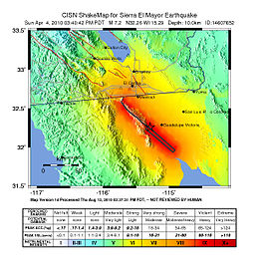
Sierra El Mayor Earthquake, Baja California M 7.2 April 4th, 2010
ShakeMap from USGS, star shows epicenter of the earthquake
Oblique Slip movement on a newly discovered fault line found using InSAR

Slide 3
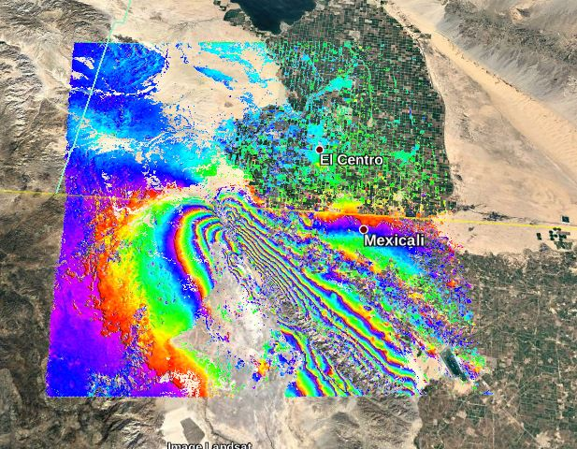
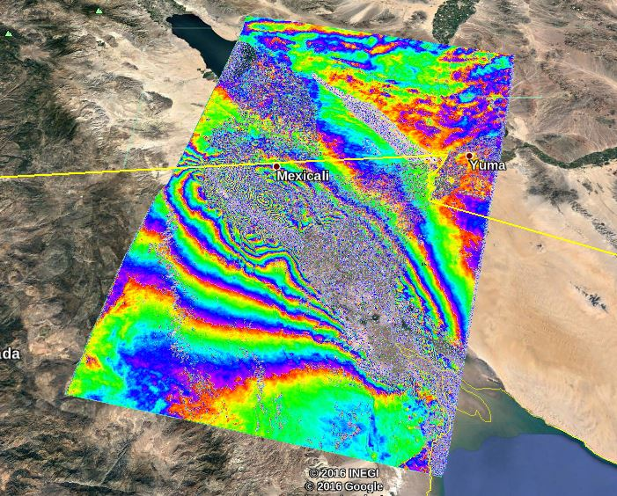
Envisat Interferogram (left) descending scene and ALOS Interferogram (right) ascending scene, Sierra El Major Earthquake

Slide 4
